Slide 1


Hyperledger Fabric
Sriram
Technology of Trust

Slide 2


Hyperledger Fabric

Slide 3

Objectives
After completing this module, you should be able to:
Develop & deploy business networks
Interact with Hyperledger Fabric Blockchain using Hyperledger Composer
Infer Hyperledger Fabric

Slide 4


In this step by step tutorial we’ll be locally setting up a business network, defining our assets, participants and transactions, and testing our network by creating some participants and an asset, and submitting transactions to change the ownership of the asset from one to another

Slide 5
Step One: Create a Business Network Definition
The key concept for Composer is the Business Network Definition (BND). It defines the data model, business logic and access control rules for your blockchain solution.
We will begin by cloning a sample business network. Open up a command prompt and execute the following
command:
git clone https://github.com/hyperledger/composer-sample-networks.git
Make a copy of this directory in your project, called 'my-network’ by using the following command:
cp -r ./composer-sample-networks/packages/basic-sample-network/ ./my-network

Slide 6
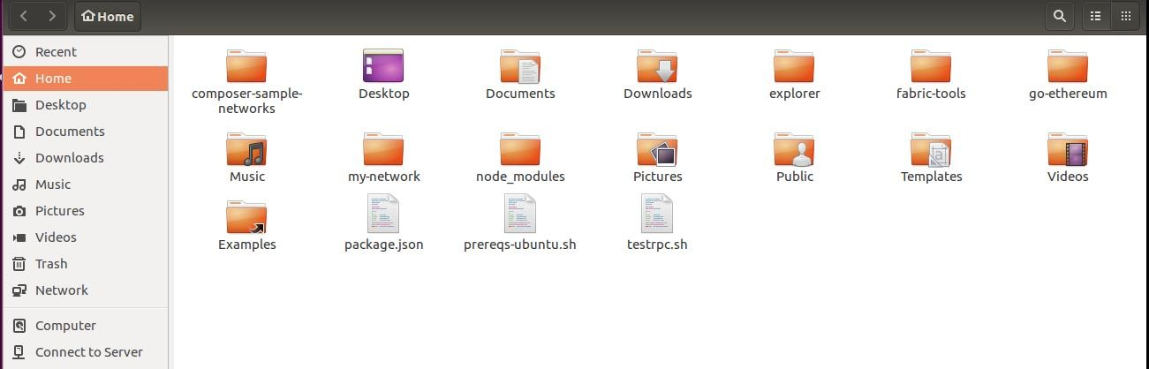
Folder Location
By default the file is located in the home location

Slide 7
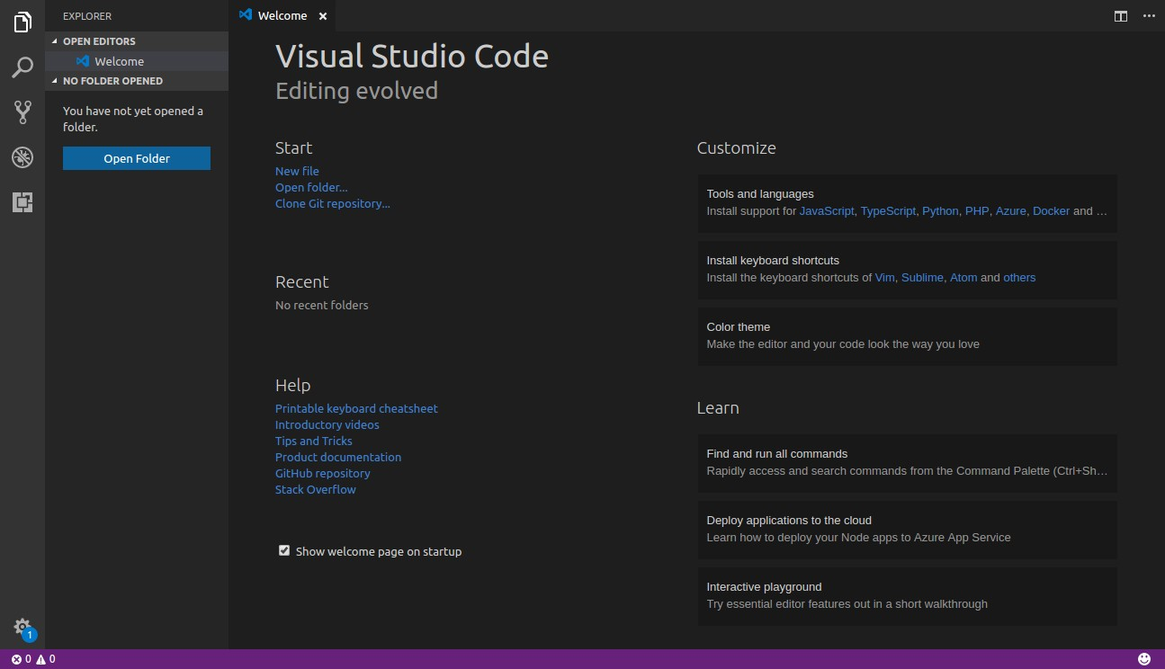
Step Two: Opening Project File
Open Visual Studio(VS) Code and click on Open Folder

Slide 8
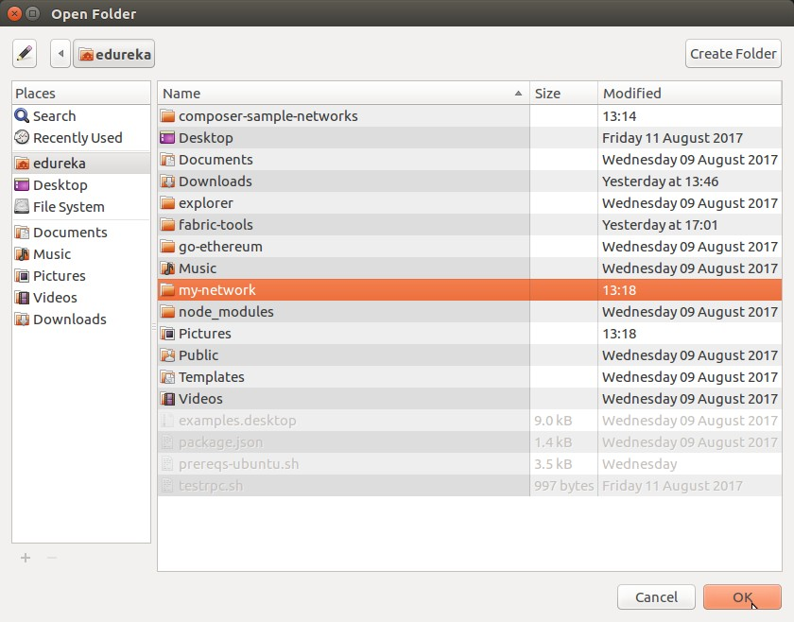
Selecting the Project Folder
Select the my-network folder and click on OK

Slide 9
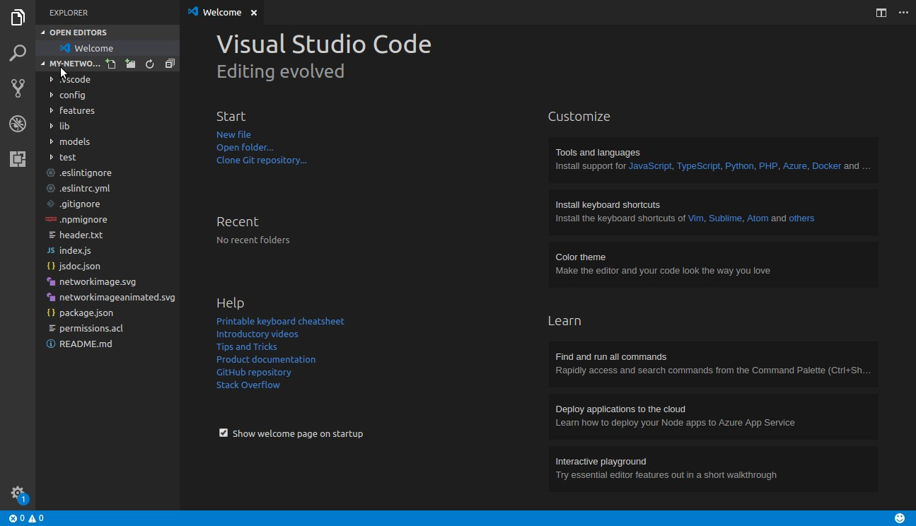
Step Three: Update your package.json file
In the left panel, select package.json file under my-network folder

Slide 10
Step Three: Update your package.json file
Update the file with the following codes:
"name": "my-network",
"version": "0.1.6",
"description": "My Commodity Trading network",
"networkImage": "https://hyperledger.github.io/composer-sample-networks/packages/basic-sample- network/networkimage.svg",
"networkImageanimated": "https://hyperledger.github.io/composer-sample-networks/packages/basic- sample-network/networkimageanimated.svg",
"scripts": {
"prepublish": "mkdirp ./dist ; composer archive create --sourceType dir --sourceName . -a
./dist/my-network.bna", "pretest": "npm run lint", "lint": "eslint .", "postlint": "npm run licchk", "licchk": "license-check", "postlicchk": "npm run doc",
"doc": "jsdoc --pedantic --recurse -c jsdoc.json", "test-inner": "mocha -t 0 --recursive && cucumber-js", "test-cover": "nyc npm run test-inner",
"test": "npm run test-inner"
},

Slide 11
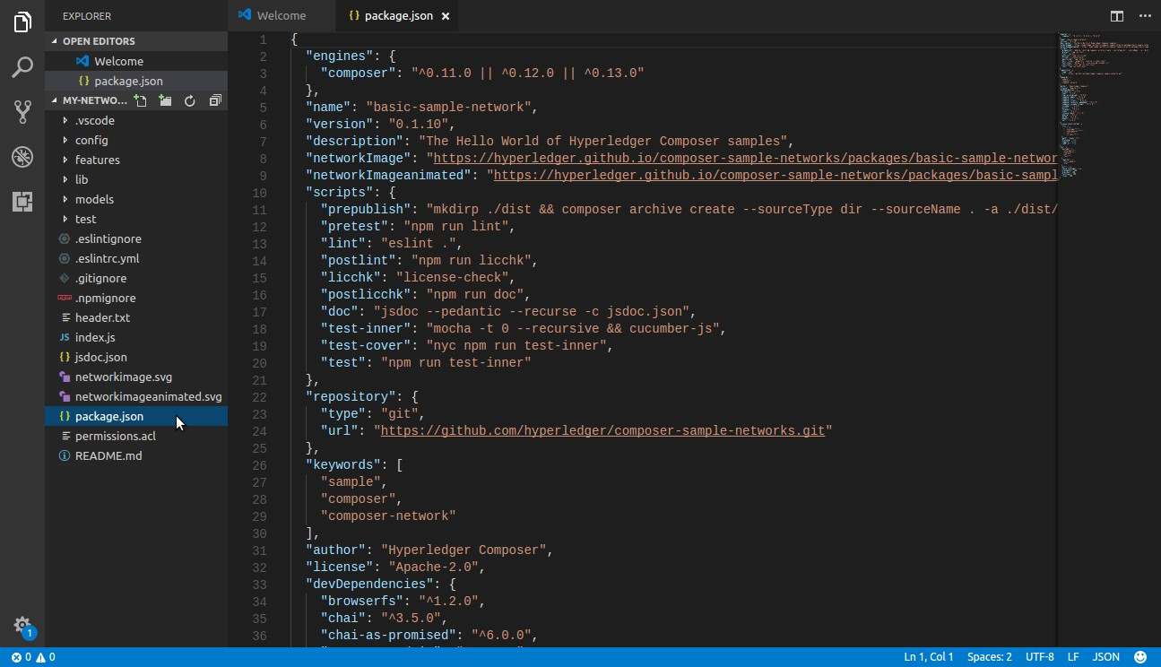
Step Three: Update your package.json file

Slide 12
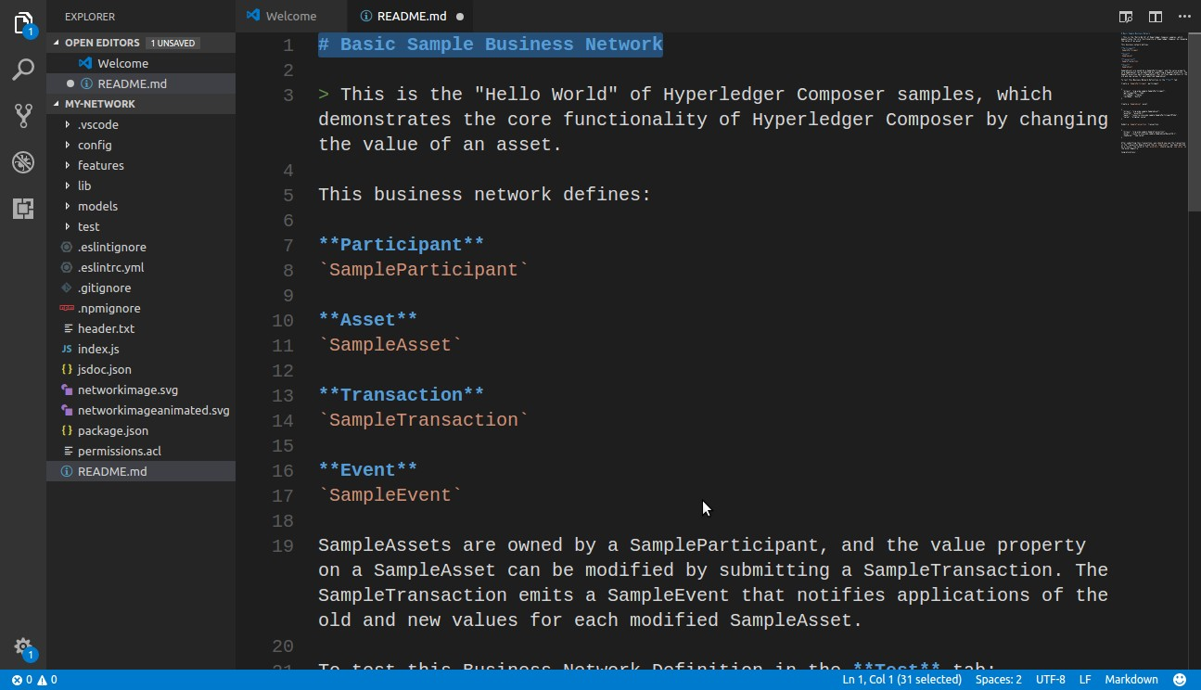
Step Four: Update README.md File
Open README.md file and Update the first line as seen bellow:

Slide 13


Step Five: Define your Domain Model
Open the file models/sample.cto file
This is the domain model for the business network definition. It defines the structure (schema) for the assets, transaction and participants in the business network
Replace the existing code with the following code:
/**
* My commodity trading network
*/
namespace org.acme.mynetwork
asset Commodity identified by tradingSymbol { o String tradingSymbol
String description
String mainExchange
Double quantity
--> Trader owner
}
participant Trader identified by tradeId { o String tradeId
String firstName
String lastName
}
transaction Trade {
--> Commodity commodity
--> Trader newOwner
}

Slide 14
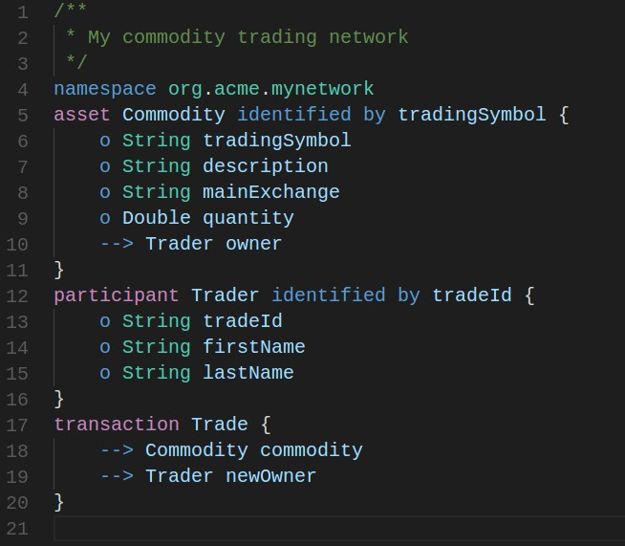
Step Five: Define your Domain Model

Slide 15
Step Six: Write Transaction Processor Functions
Now that the domain model has been defined, we can write the business logic for the business network definition.
Composer expresses the logic for a business network using JavaScript functions.
These functions are automatically executed when a transaction is submitted for processing.
Open the file lib/sample.js in the left-hand pane
Update the sample.js file with the following code.

Slide 16
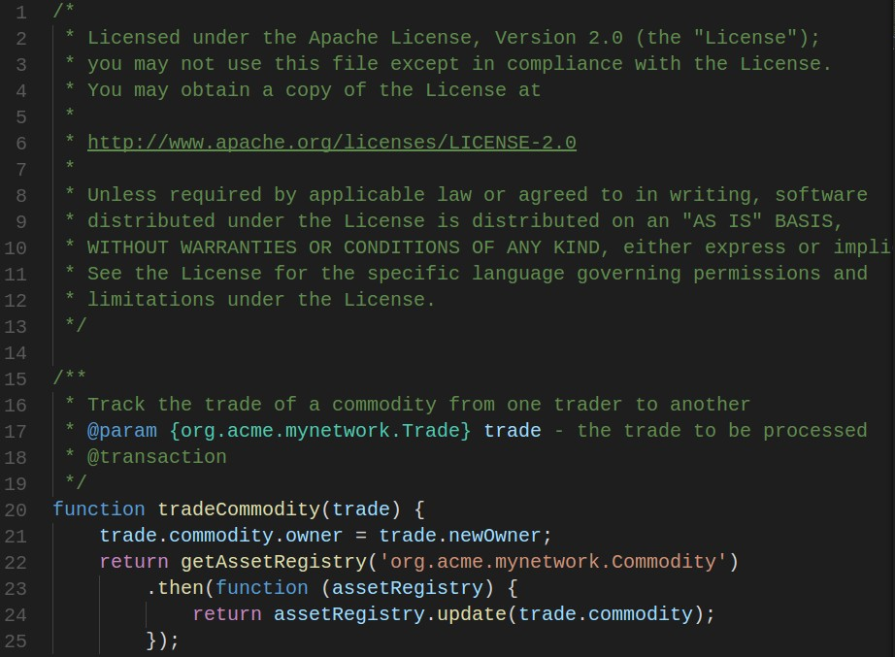
Step Six: Write Transaction Processor Functions

Slide 17
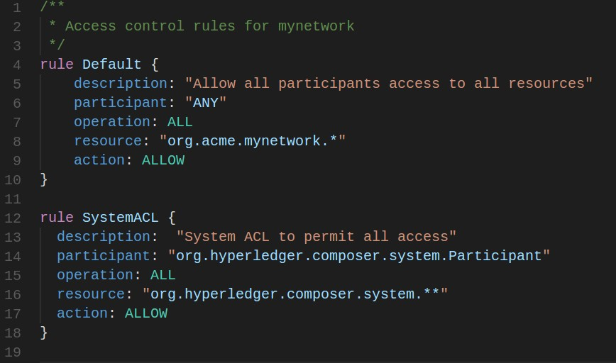
Step Seven: Update your Access Control Rules
The file permissions.acl defines the access control rules for the business network definition. Replace the entire contents of permissions.acl with the rule below:

Slide 18
Step Eight: Generate the Business Network Archive
Let us now generate a Business Network Archive (BNA) file for our business network definition to check the validity of the structure of the files we have manipulated.
The BNA file is the deployable unit - a file that can be deployed to the Composer runtime for execution.
The file gets created in the following path:
– /home/my-network/dist
Open a new Terminal and execute the following command:
cd my-network
npm install

Slide 19
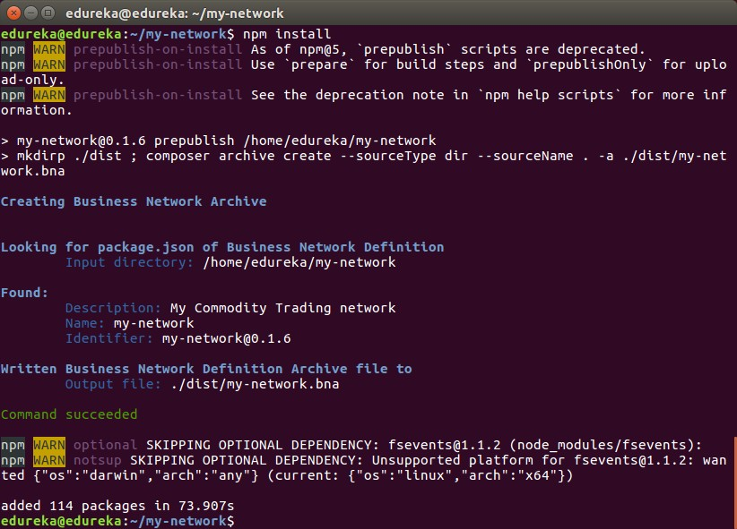
Step Eight: Generate the Business Network Archive

Slide 20
Step Nine: Write Unit Tests
All code should have unit tests - even your business network logic! We will be adding a simple unit test for the business network definition
The unit test will run against the embedded runtime. The embedded runtime actually stores the state of 'the
blockchain' in-memory in a Node.js process
This embedded runtime is very useful for unit testing, as it allows you to focus on testing the business logic rather than configuring an entire Fabric
Return to VS code and Open Sample.js present in my-network/test/
Replace the existing code with the following code:

Slide 21
Step Ten: Update your sample.js file(I)
/ * Licensed under the Apache License, Version 2.0 (the "License");
you may not use this file except in compliance with the License.
You may obtain a copy of the License at
*
http://www.apache.org/licenses/LICENSE-2.0
*
Unless required by applicable law or agreed to in writing, software
distributed under the License is distributed on an "AS IS" BASIS,
WITHOUT WARRANTIES OR CONDITIONS OF ANY KIND, either express or implied.
See the License for the specific language governing permissions and
limitations under the License.
*/
'use strict';
const AdminConnection = require('composer-admin').AdminConnection; const BrowserFS = require('browserfs/dist/node/index');
const BusinessNetworkConnection = require('composer-client').BusinessNetworkConnection; const BusinessNetworkDefinition = require('composer-common').BusinessNetworkDefinition; const path = require('path');
require('chai').should();
const bfs_fs = BrowserFS.BFSRequire('fs'); const NS = 'org.acme.mynetwork';

Slide 22

Step Ten: Update your sample.js file(II)
describe('Commodity Trading', () => {
// let adminConnection;
let businessNetworkConnection;
before(() => {
BrowserFS.initialize(new BrowserFS.FileSystem.InMemory()); const adminConnection = new AdminConnection({ fs: bfs_fs }); return adminConnection.createProfile('defaultProfile', {
type: 'embedded'
})
.then(() => {
return adminConnection.connect('defaultProfile', 'admin', 'adminpw');
})
.then(() => {
return BusinessNetworkDefinition.fromDirectory(path.resolve( dirname, '..'));
})
.then((businessNetworkDefinition) => {
return adminConnection.deploy(businessNetworkDefinition);
})
.then(() => {
businessNetworkConnection = new BusinessNetworkConnection({ fs: bfs_fs });
return businessNetworkConnection.connect('defaultProfile', 'my-network', 'admin', 'adminpw');
});
});

Slide 23
Step Ten: Update your sample.js file(III)
describe('#tradeCommodity', () => {
it('should be able to trade a commodity', () => {
const factory = businessNetworkConnection.getBusinessNetwork().getFactory();
// create the traders
const dan = factory.newResource(NS, 'Trader', 'dan@email.com'); dan.firstName = 'Dan';
dan.lastName = 'Selman';
const simon = factory.newResource(NS, 'Trader', 'simon@email.com'); simon.firstName = 'Simon';
simon.lastName = 'Stone';
// create the commodity
const commodity = factory.newResource(NS, 'Commodity', 'EMA'); commodity.description = 'Corn';
commodity.mainExchange = 'Euronext'; commodity.quantity = 100;
commodity.owner = factory.newRelationship(NS, 'Trader', dan.$identifier);
// create the trade transaction
const trade = factory.newTransaction(NS, 'Trade');
trade.newOwner = factory.newRelationship(NS, 'Trader', simon.$identifier); trade.commodity = factory.newRelationship(NS, 'Commodity', commodity.$identifier);
// the owner should of the commodity should be dan commodity.owner.$identifier.should.equal(dan.$identifier);

Slide 24
Step Ten: Update your sample.js file(IV)
// Get the asset registry. let commodityRegistry;
return businessNetworkConnection.getAssetRegistry(NS + '.Commodity')
.then((assetRegistry) => {
commodityRegistry = assetRegistry;
// add the commodity to the asset registry. return commodityRegistry.add(commodity);
})
.then(() => {
return businessNetworkConnection.getParticipantRegistry(NS + '.Trader');
})
.then((participantRegistry) => {
// add the traders
return participantRegistry.addAll([dan, simon]);
})
.then(() => {
// submit the transaction
return businessNetworkConnection.submitTransaction(trade);
})
.then(() => {
// re-get the commodity
return commodityRegistry.get(commodity.$identifier);
})
.then((newCommodity) => {
// the owner of the commodity should now be simon newCommodity.owner.$identifier.should.equal(simon.$identifier);
}); }); }); });

Slide 25
Step Eleven: Cucumber Testing (I)
Open features/sample.feature file in VS code and replace the existing code with the following code:
# Licensed under the Apache License, Version 2 (the "License"); # you may not use this file except in compliance with the License. # You may obtain a copy of the License at
#
# http://www.apache.org/licenses/LICENSE-2 #
# Unless required by applicable law or agreed to in writing, software # distributed under the License is distributed on an "AS IS" BASIS,
# WITHOUT WARRANTIES OR CONDITIONS OF ANY KIND, either express or implied.
# See the License for the specific language governing permissions and # limitations under the License.
#
Feature: Sample Background:
Given I have deployed the business network definition ..
And I have added the following participants of type org.acme.mynetwork.Trader
| tradeId | firstName | lastName |
| alice@email.com | Alice
| bob@email.com | Bob
| A
| B
|
|
And I have added the following assets of type org.acme.mynetwork.Commodity
| tradingSymbol | description | mainExchange | quantity | owner |
| 1
| 2
| One
| Two
| London
| Paris
| 1 | alice@email.com |
| 2 | bob@email.com |

Slide 26
Step Eleven: Cucumber Testing (II)
And I have issued the participant org.acme.mynetwork.Trader#alice@email.com with the identity alice1 And I have issued the participant org.acme.mynetwork.Trader#bob@email.com with the identity bob1
Scenario: Alice can read all of the assets
When I use the identity alice1
Then I should have the following assets of type org.acme.mynetwork.Commodity
| tradingSymbol | description | mainExchange | quantity | owner |
| | 1 | | One | | London | | 1 | | alice@email.com | |
| | 2 | | Two | | Paris | | 2 | | bob@email.com | |
Scenario: Bob can read all of the assets When I use the identity bob1
Then I should have the following assets of type org.acme.mynetwork.Commodity
| tradingSymbol | description | mainExchange | quantity | owner
|
| 1
| 2
| One
| Two
| London
| Paris
| 1
| 2
| alice@email.com |
| bob@email.com |
Scenario: Alice can add assets that she owns When I use the identity alice1
And I add the following asset of type org.acme.mynetwork.Commodity
| tradingSymbol | description | mainExchange | quantity | owner |
| 3 | Three | New York | 3 | alice@email.com | Then I should have the following assets of type org.acme.mynetwork.Commodity
| tradingSymbol | description | mainExchange | quantity | owner |
| 3 | Three | New York | 3 | alice@email.com | Scenario: Bob can add assets that he owns
When I use the identity bob1
And I add the following asset of type org.acme.mynetwork.Commodity

Slide 27
Step Eleven: Cucumber Testing (III)
| tradingSymbol | description | mainExchange | quantity | owner
|
| bob@email.com |
| 4 | Four | Rome | 4
Scenario: Alice can update her assets When I use the identity alice1
And I update the following asset of type org.acme.mynetwork.Commodity
| tradingSymbol | description | mainExchange | quantity | owner |
| 1 | One | London | 5 | alice@email.com | Then I should have the following assets of type org.acme.mynetwork.Commodity
| tradingSymbol | description | mainExchange | quantity | owner |
| 1 | One
Scenario: Bob can update his assets When I use the identity bob1
| London | 5 | alice@email.com |
And I update the following asset of type org.acme.mynetwork.Commodity
| tradingSymbol | description | mainExchange | quantity | owner |
| 2 | Two | Paris | 6 | bob@email.com |
Then I should have the following assets of type org.acme.mynetwork.Commodity
| tradingSymbol | description | mainExchange | quantity | owner |
| 2 | Two | Paris | 6 | bob@email.com | Scenario: Alice can remove her assets
When I use the identity alice1
And I remove the following asset of type org.acme.mynetwork.Commodity
| tradingSymbol |
| 1 |
Then I should not have the following assets of type org.acme.mynetwork.Commodity
| tradingSymbol |
| 1 |

Slide 28
Step Eleven: Cucumber Testing (IV)
Scenario: Bob can remove his assets When I use the identity bob1
And I remove the following asset of type org.acme.mynetwork.Commodity
| tradingSymbol |
| 2 |
Then I should not have the following assets of type org.acme.mynetwork.Commodity
| tradingSymbol |
| 2 |
Scenario: Alice can submit a transaction for her assets When I use the identity alice1
And I submit the following transaction of type org.acme.mynetwork.Trade
| commodity | newOwner |
| 1 | bob@email.com |
Then I should have the following assets of type org.acme.mynetwork.Commodity
| tradingSymbol | description | mainExchange | quantity | owner |
| 1 | One | London | 1 | bob@email.com | Scenario: Bob can submit a transaction for his assets
When I use the identity bob1
And I submit the following transaction of type org.acme.mynetwork.Trade
| commodity | newOwner |
| 2 | alice@email.com |
Then I should have the following assets of type org.acme.mynetwork.Commodity
| tradingSymbol | description | mainExchange | quantity
| 2 | Two | Paris | 2
| owner
| alice@email.com |
|

Slide 29
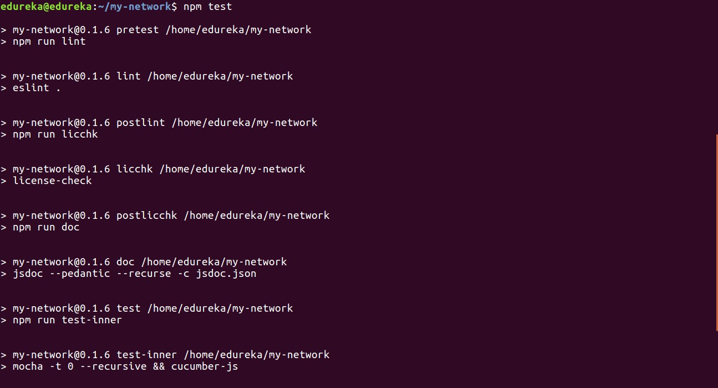
Step Eleven: Cucumber Testing (V)
Check that the unit tests pass by switching back to the terminal and typing:
– npm test

Slide 30
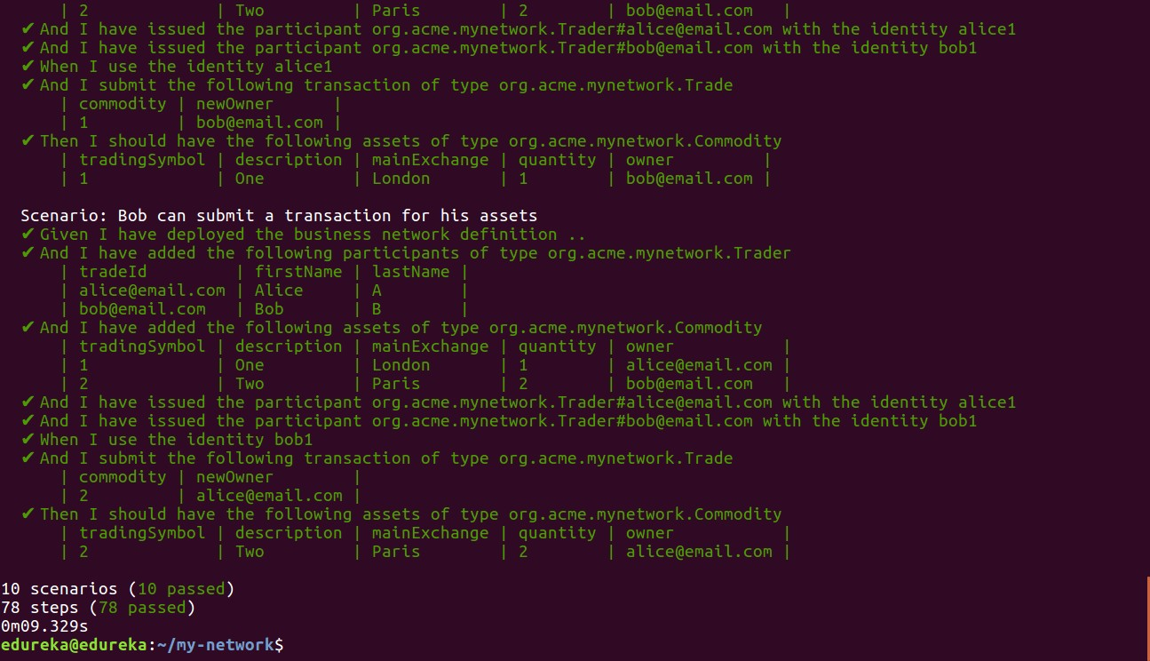
Step Eleven: Cucumber Testing (VI)

Slide 31
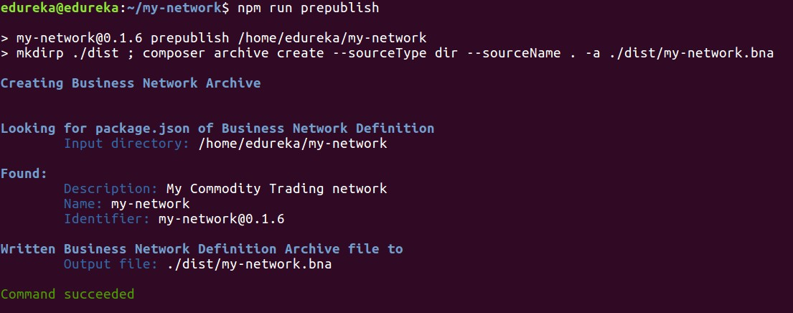
Step Twelve: Creating BNA file
Ensure you are at the top level project folder (my-network). Generate the BNA file using the following command:
mkdir dist
composer archive create -a dist/my-network.bna --sourceType dir --sourceName
You can also use the command npm run prepublish achieves the same thing.

Slide 32
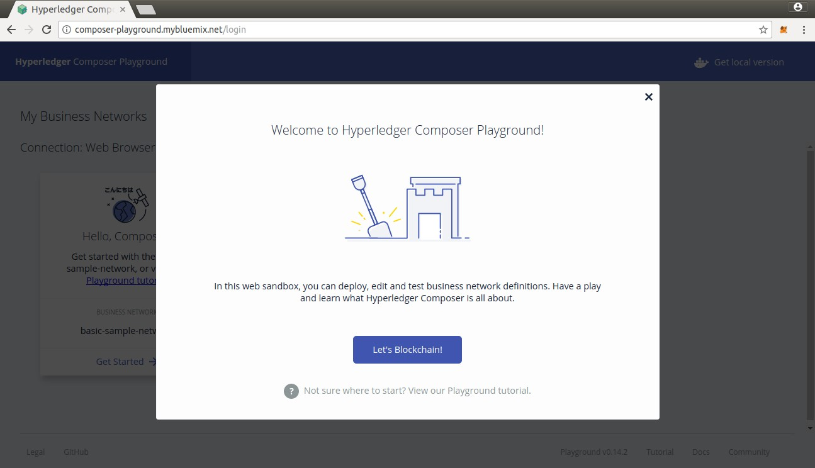
Step Thirteen: Deploying Business Network to Composer
In Chrome browser, navigate to the online Bluemix Composer Playground.

Slide 33
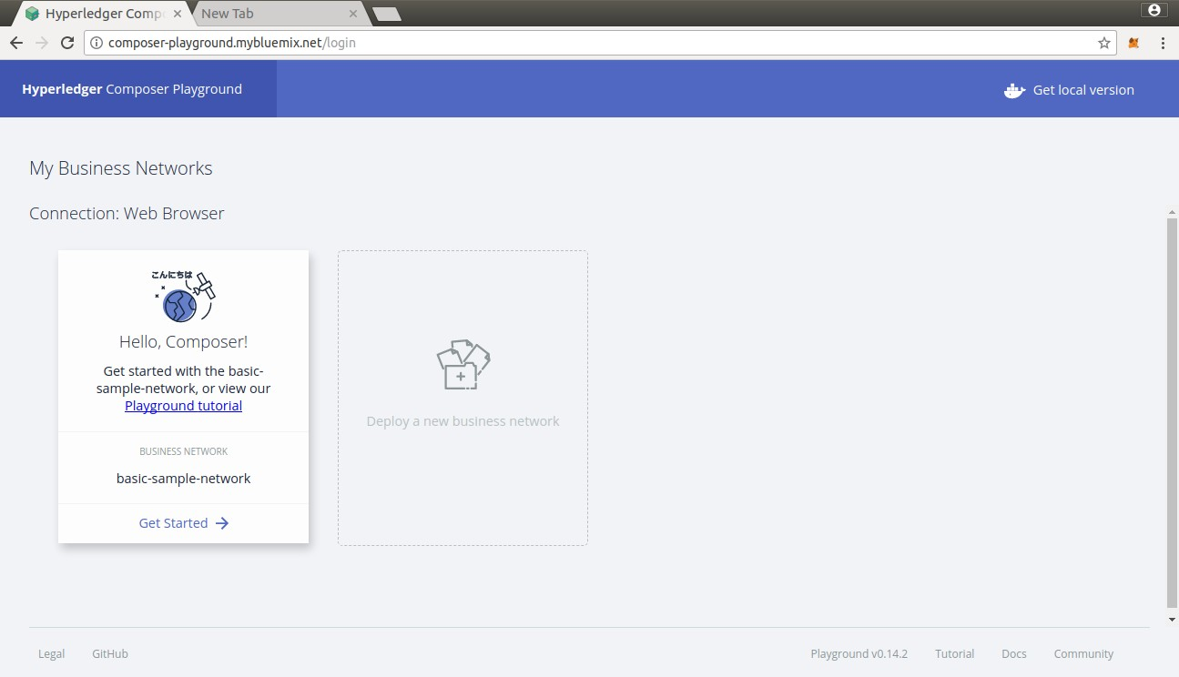
Step Thirteen: Deploying Business Network (I)
Click on Deploy a new business network

Slide 34
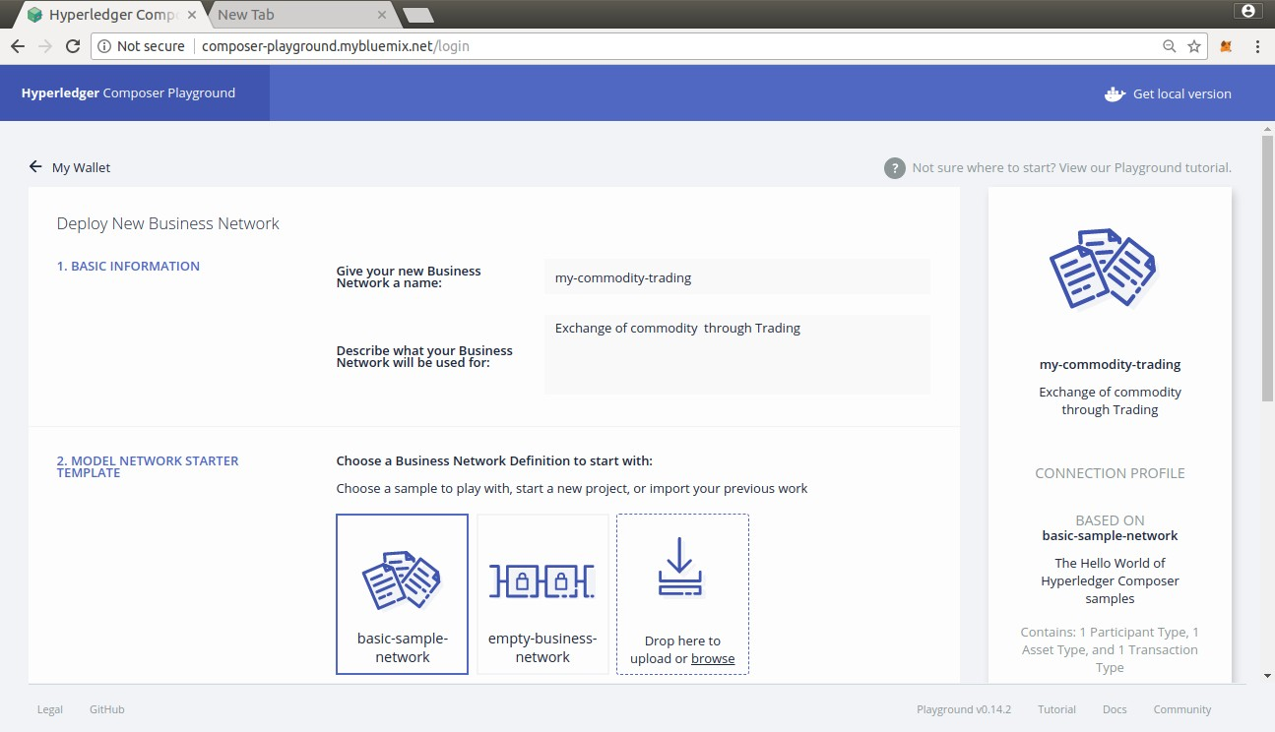
Step Thirteen: Deploying Business Network (II)
Update the fields with data as seen below and click on Drop here to upload or browse

Slide 35
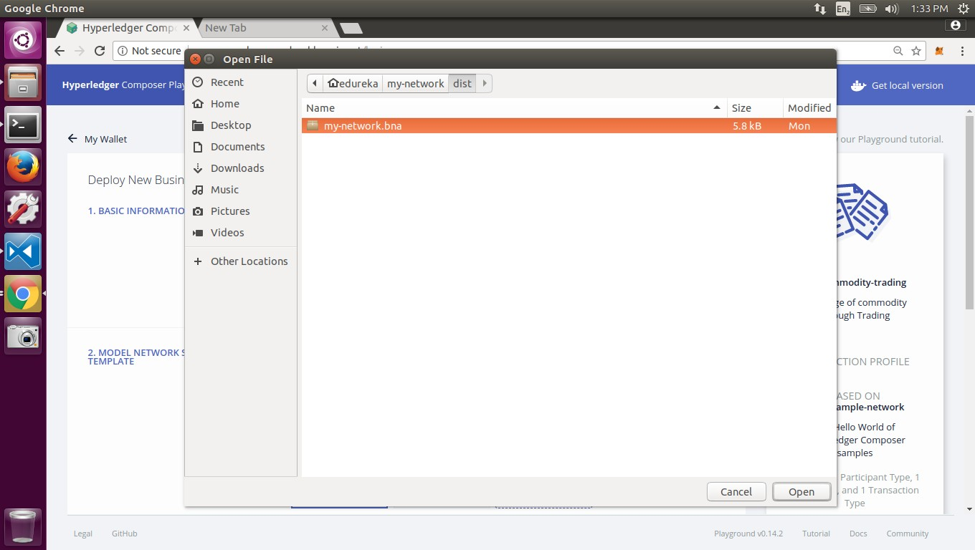
Step Thirteen: Deploying Business Network (III)
Choose your my-network.bn file from your system

Slide 36
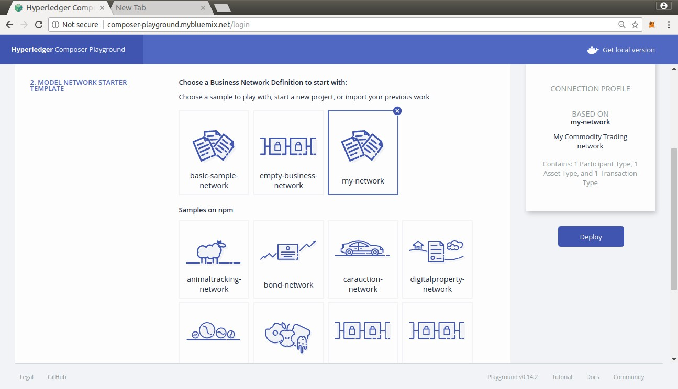
Step Thirteen: Deploying Business Network (IV)
Once the file is uploaded, Click on Deploy.

Slide 37
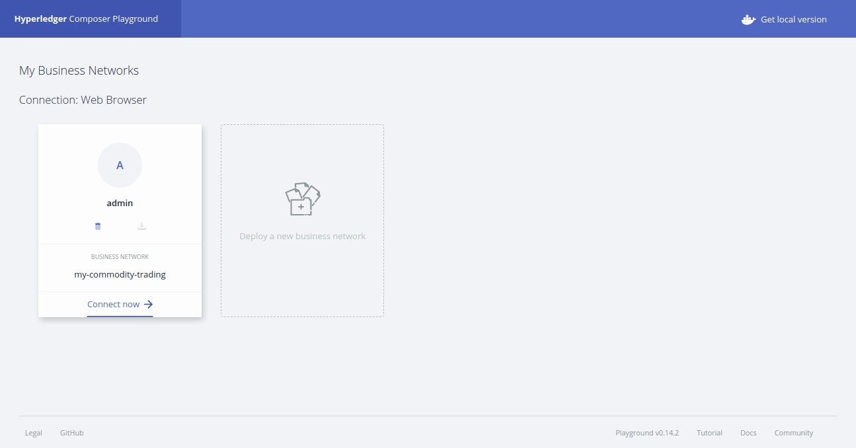
Step Thirteen: Deploying Business Network (V)
Click on Connect now to connect to the deployed Business Network.

Slide 38
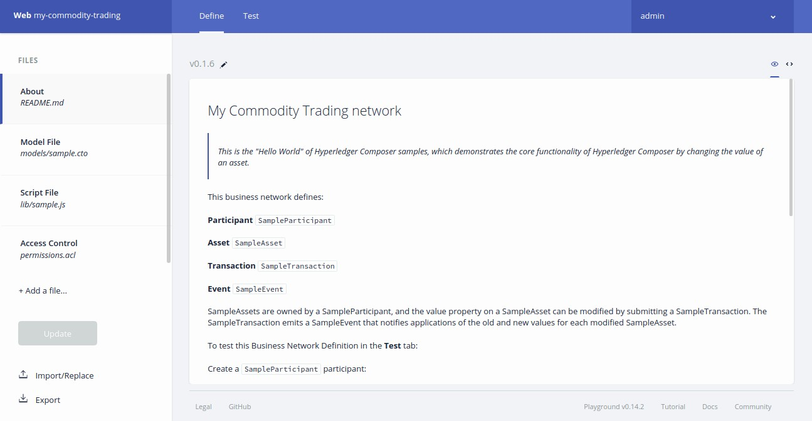
Step Thirteen: Deploying Business Network (VI)

Slide 39
Step Fourteen: Creating Traders
Click on Test Option and Ensure you are in Trader Participant plane.
Add 2 New participants with the codes below:
Participant 1
Participant 2
{
"$class": "org.acme.mynetwork.Trader", "tradeId": "TRADER1",
"firstName": "James",
"lastName": “Smith”
}
{
"$class": "org.acme.mynetwork.Trader",
"tradeId": "TRADER2", "firstName": “John", "lastName": “Snow“
}

Slide 40


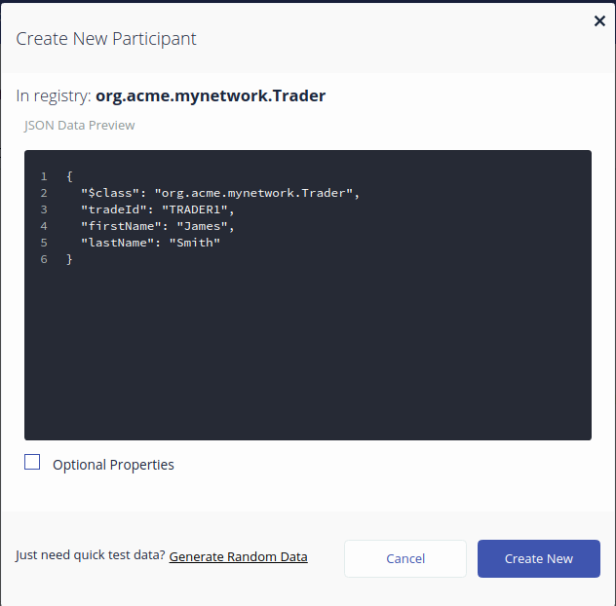
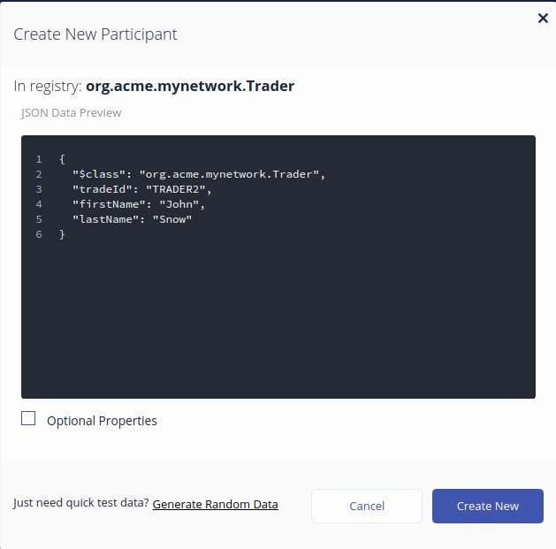
Step Fourteen: Creating Traders
Click on Create New once the codes are updated.

Slide 41
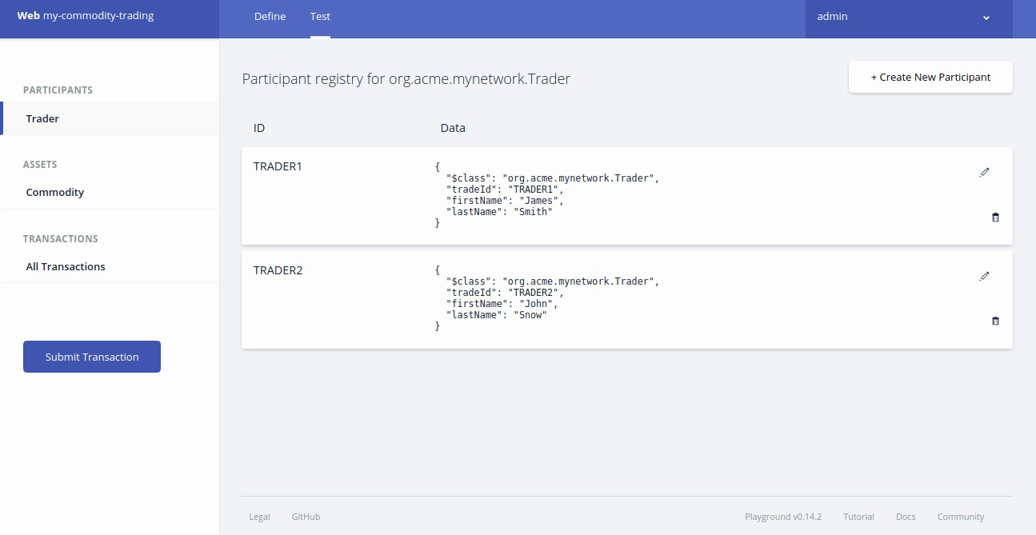
Step Fourteen: Creating Traders

Slide 42
Step Fifteen: Creating Commodity
Switch to Commodities tab under Assets tab and Click on add commodity option.
Replace the existing code with the code below:
Commodity
{
"$class": "org.acme.mynetwork.Commodity", "tradingSymbol": "ABC",
"description": "Test commodity", "mainExchange": "Euronext", "quantity": 72.297,
"owner": "resource:org.acme.mynetwork.Trader#TRADER1"
}

Slide 43

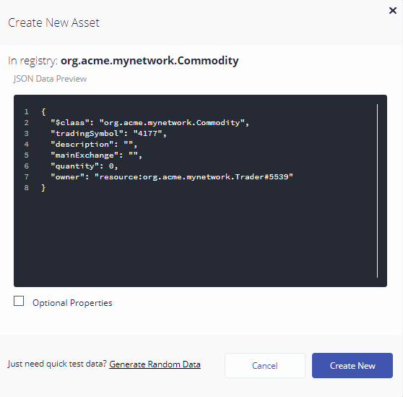
Step Fifteen: Creating Commodity

Slide 44
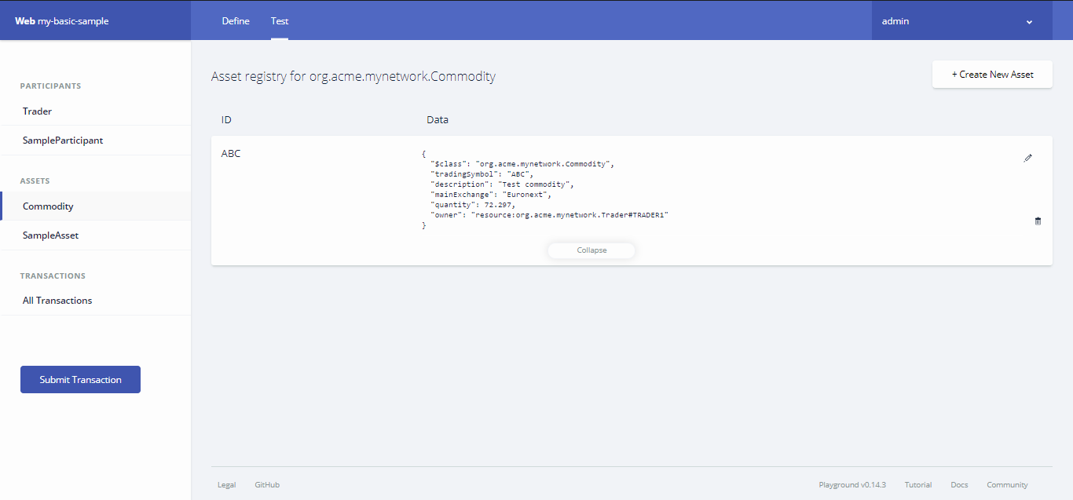
Step Fifteen: Creating Commodity

Slide 45
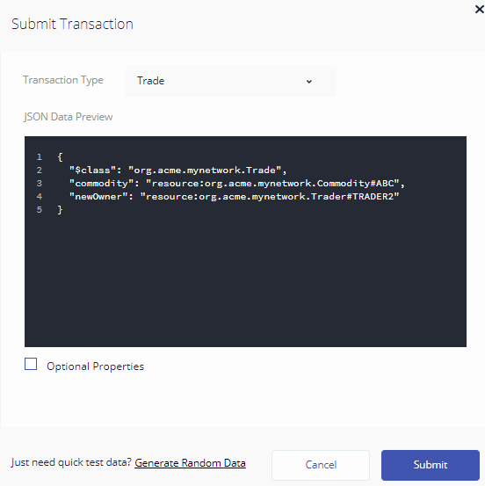
Step Sixteen: Initiating a Trade
Initiate a trade by selecting Submit Button.
Replace the existing code with the code below:
{
"$class": "org.acme.mynetwork.Trade", "commodity": "resource:org.acme.mynetwork.Commodity#ABC", "newOwner": "resource:org.acme.mynetwork.Trader#TRADER2"
}

Slide 46
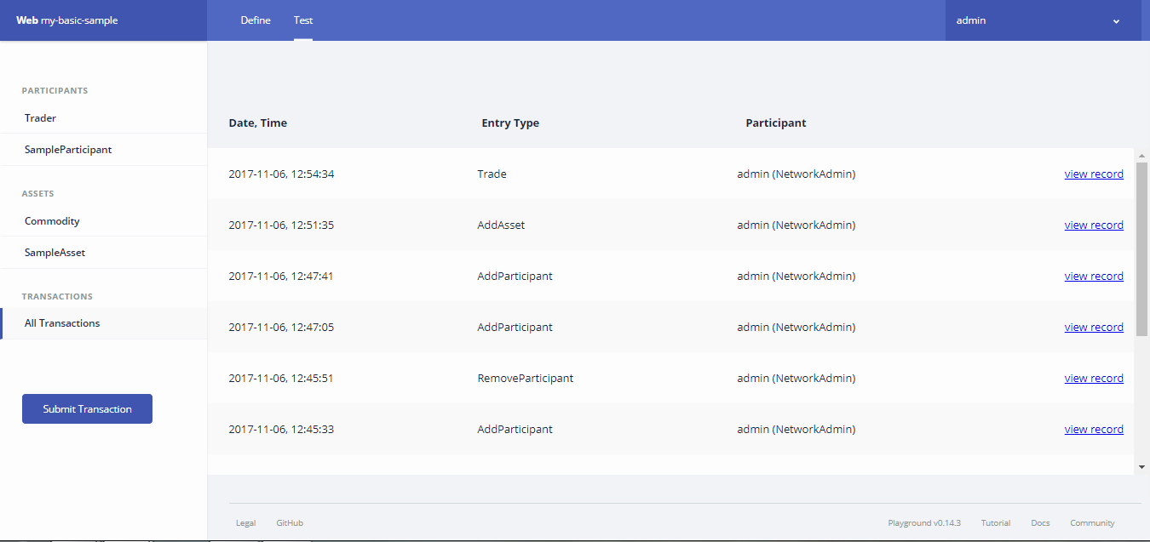

Step Seventeen: Validating the Trade
Go to the Transaction history and owners tab to validate that the asset has been transferred to the new owner as seen below:

Slide 47
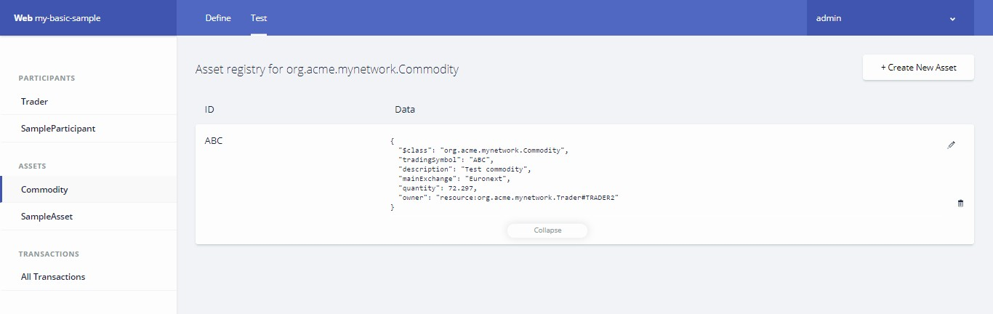
Step Seventeen: Validating the Trade
As a result of the trade, the owner of the commodity ABC should now be owned TRADER2.

Slide 48
Step Eighteen: Deploying to Hyperledger Fabric
So far, we've created our business network definition, written a unit test and interactively tested the solution in the Playground.
Now it is time to deploy to a real blockchain! We are going to deploy the BNA (suffix .bna) file to Hyperledger
Fabric v1.0
Switch to the terminal, change directory to the my-network/dist folder containing the my-network.bna file and execute the following command:
cd dist
composer network deploy -a my-network.bna -p hlfv1 -i PeerAdmin -s randomString

Slide 49
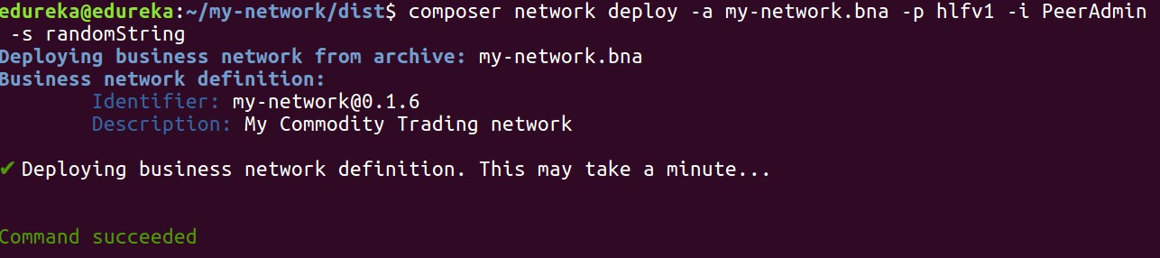
Step Eighteen: Deploying to Hyperledger Fabric
After approximately 30 seconds or so, the business network should have been deployed to your local Hyperledger Fabric. You should see output as follows:
You can verify that the network has been deployed by typing:
– composer network ping -n my-network -p hlfv1 -i admin -s adminpw

Slide 50

About Hyperledger Fabric
After covering the practical aspect of hyperledger, let’s talk about some concepts of Hyperledger Fabric

Slide 51
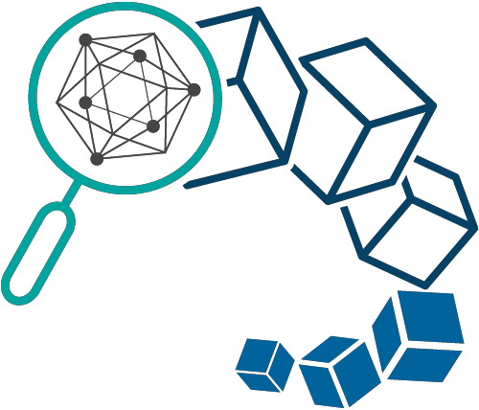
Hyperledger Fabric
01
A permissioned system where the members of a Hyperledger Fabric network enrol through
a Membership Service Provider (MSP)
Offers several pluggable options. Ledger data can be stored in multiple formats, consensus mechanisms can be switched in and out, and different MSPs are supported
02
03
Also offer the ability to create channels, allowing a group of participants to create a separate ledger of transactions

Slide 52


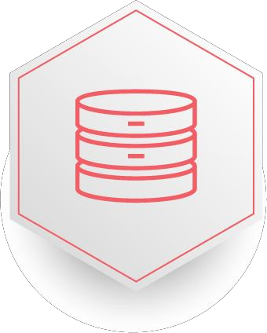
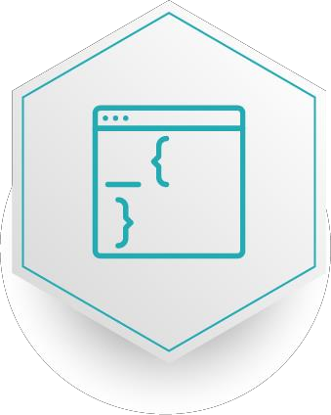
Key Benefits of Hyperledger Fabric
Data Protection & Consistency
Use permissions to ensure accountability of membership & access rights
Confidential transactions Use Give businesses the flexibility & security to make transactions visible to select parties with the correct encryption keys
No cryptocurrency Does not require mining & expensive computations to assure transactions
Programmable Leverage the embedded logic in smart contracts to automate business process
across your network

Slide 53
How is Hyperledger different from other Blockchain
Characteristics | Bitcoin | Ethereum | Hyperledger Fabric
Cryptocurrency required | bitcoin | ether, user-created cryptocurrencies | none
Network | public | public or permissioned | permissioned
Transactions | anonymous | anonymous or private | Public or confidential
Consensus | Proof of work | Proof of work | PBFT
Smart contracts | none | yes(Solidity, Serpent, LLL) | yes(chaincode)

Slide 54

Hyperledger Fabric Capabilities
Hyperledger Fabric delivers the following blockchain network capabilities:
Identity Management:
01
Manages user IDs and authenticates all participants on the network
Privacy and confidentiality: Enables confidential transactions, to coexist on the same permissioned network
02
Efficient processing:
Transaction execution is separated from transaction
ordering and commitment which increases processing efficiency
03
Chaincode functionality:
Encode logic that is invoked by specific types of transactions on the channel. System chaincode defines operating parameters for the entire channel
04
Modular design:
Implements a modular architecture to provide
functional choice to network designers
05

Slide 55
Hyperledger Fabric Model
Assets:
Enable the exchange of monetary value
over the network
01
Channels:
Enable multi-lateral transactions with the high degrees of privacy and confidentiality
Security & Membership Services:
In Permissioned membership participants know that all transactions can be detected and traced by authorized regulators and auditors
Consensus:
₀₆ a unique approach to consensus enables
the flexibility and scalability needed for
the enterprise
04
Chaincode: Partitioned from transaction ordering, limiting the required levels of trust and verification across node types, and optimizing network scalability and performance
Ledger Features:
for each channel, and includes SQL-like 03
Encodes the entire transaction history
query capability Privacy through
02
05

Slide 56
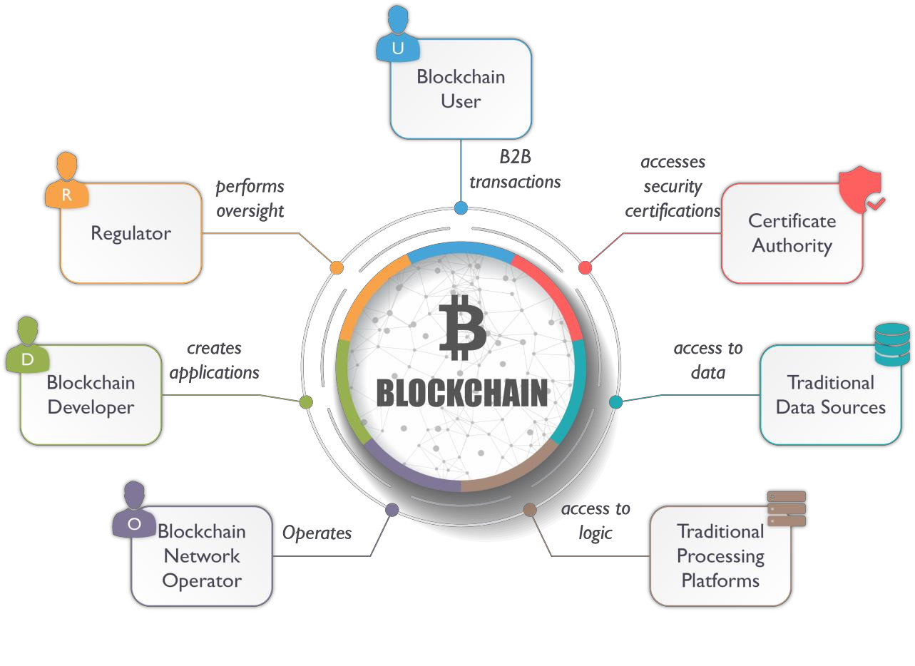
Participants in Hyperledger Blockchain Network

Slide 57




Fabric V0.6
Following are the constituents of Hyperledger Fabric V0.6:
01
02
03
04
Actors
Components
Interactions
Architecture

Slide 58



Fabric: Actors
Blockchain user
Interacts with the Blockchain using a LOB application. They are not aware of the Blockchain
Blockchain regulator
Overall authority in a business network. Specifically, regulators may require broad access to the
ledger’s contents
Blockchain developer
Developer of applications and smart contracts that interact with the Blockchain and are used by
Blockchain users
Blockchain network operator
Defines, creates, manages and monitors the Blockchain network. Each business in the network has a Blockchain Network operator
Certificate
authority
Manages the different types of certificates required to run a permissioned Blockchain
Traditional
processing platform
Existing computer system which may be used by the Blockchain to augment processing
Traditional data sources
Existing data system which may provide data to influence the behaviour smart contracts

Slide 59



Fabric: Components
Ledger Contains current World State of ledger and a Blockchain of transaction invocations
Smart contract
Encapsulates business network transactions into logic code
Consensus network
Collection of network data processing peers forming a Blockchain network
Membership
Manages identity and transaction certificates & other aspects of permissioned access

Slide 60


Fabric: Components(Contd…)
Events
Creates notifications on blockchain notification related to smart contracts
System management
Provides the ability to create, change and monitor Blockchain components
Wallet
Securely manages a user’s security credentials
System
integration
Not responsible for integrating blockchain bi-directionally with external systems

Slide 61
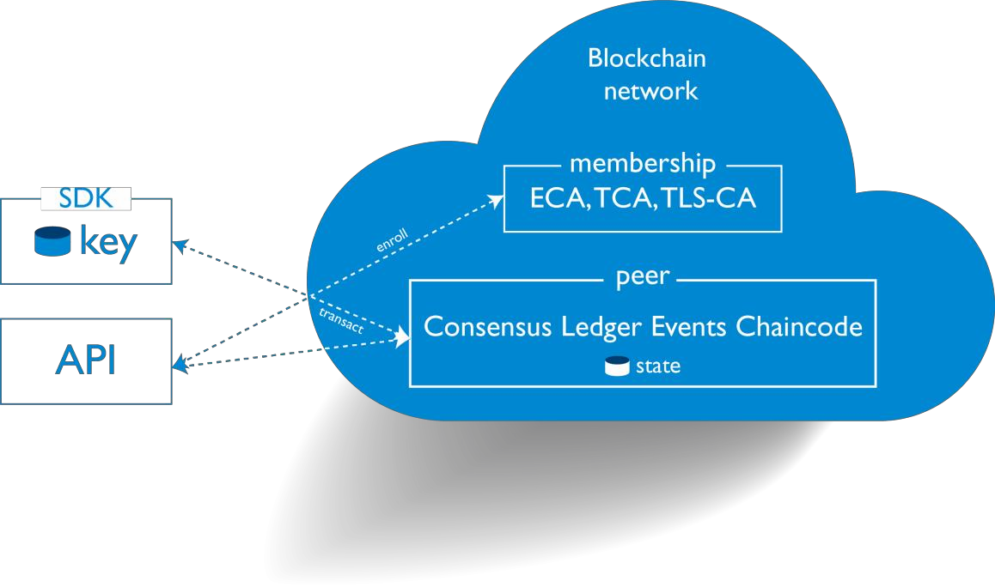
Fabric: Interactions
Protocols:
SDK: use gRPC to communicate with a blockchain peer
or Certificate Authority. Maintain the user’s key wallet
HTTP API: use HTTP (deprecated in V1.0)
Functional interaction methods:
DEPLOY*: to deploy a chaincode
Query: to retrieve data from World State
INVOKE*: to call a chaincode method creating a transaction
(*Creates a block on the chain)

Slide 62
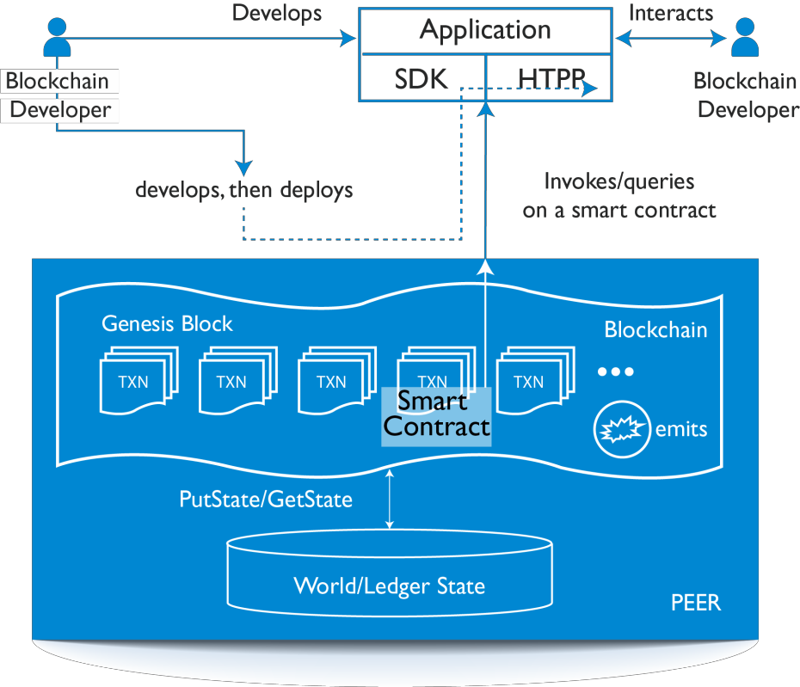
Fabric Architecture
Blockchain developer codes Application and Smart Contract
He deploys the app on a server and smart
contract on a peer using DEPLOY
A registered user interacts with the app sending order (INVOKE) or retrieving information (QUERY) through the smart contract
Smart contract can emit an event subscribed by the app

Slide 63
Fabric V1.0
Following are the constituents of Fabric V1.0:
Plugging external identity server
Historical queries
01
02
03
04
05
06
Endorsement
/consensus
model
Plugging external State Db
HTTP API
deprecated,
use SDK
Chaincode upgrades

Slide 64



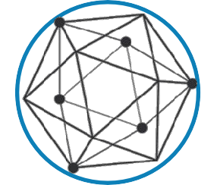



Key Features of Fabric V1.0
Channels for sharing confidential
information
01
Ordering Service delivers transactions
consistently to peers in the network
02
Bring-your-own Membership
Service Provider (MSP) 05
03
Endorsement policies for transactions
04
CouchDB world state supports wide range of queries

Slide 65
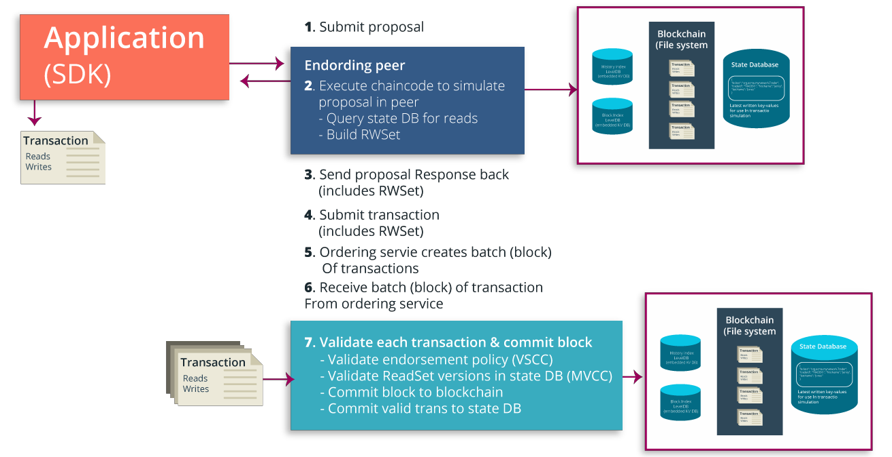
Transaction Life Cycle- Hyperledger Fabric
Endorsing
from ordering service

Slide 66
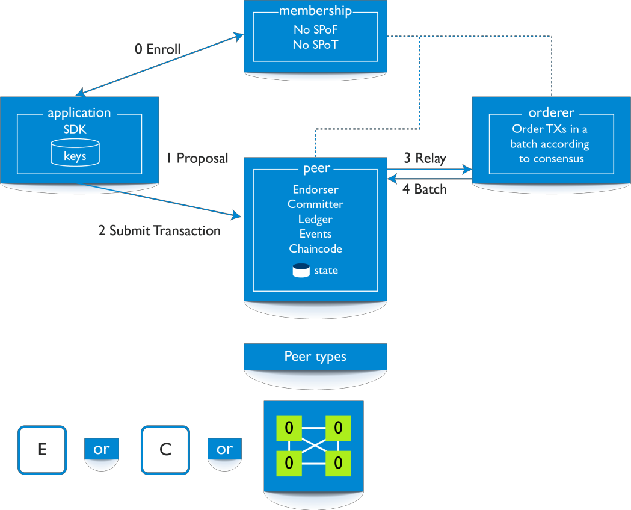
Endorsement/Consensus Model
Peer role has been split:
Committer peer:
Commits transactions, maintains ledger and state
01
Endorsing peer:
Receives a transaction proposal for endorsement, responds granting or denying endorsement
02
Ordering peer:
Approves the inclusion of transaction blocks into the ledger and communicates with peer and endorsing peer nodes
03

Slide 67
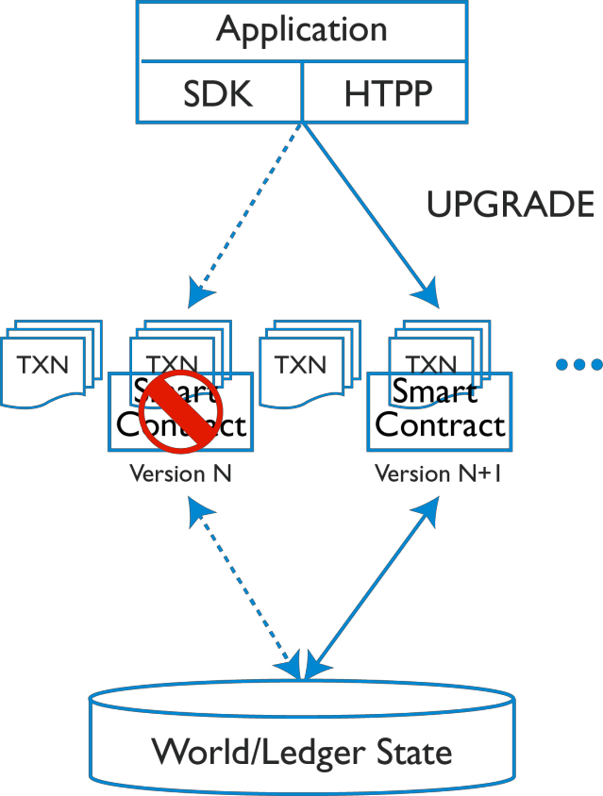


Chaincode Upgrades
Following changes with respect to Chaincode has been incorporated:
New command UPGRADE to use instead of redeploying another chaincode
Chaincode will contain version number

Slide 68


Copyright © 2017, edureka and/or its affiliates. All rights reserved.

Slide 69
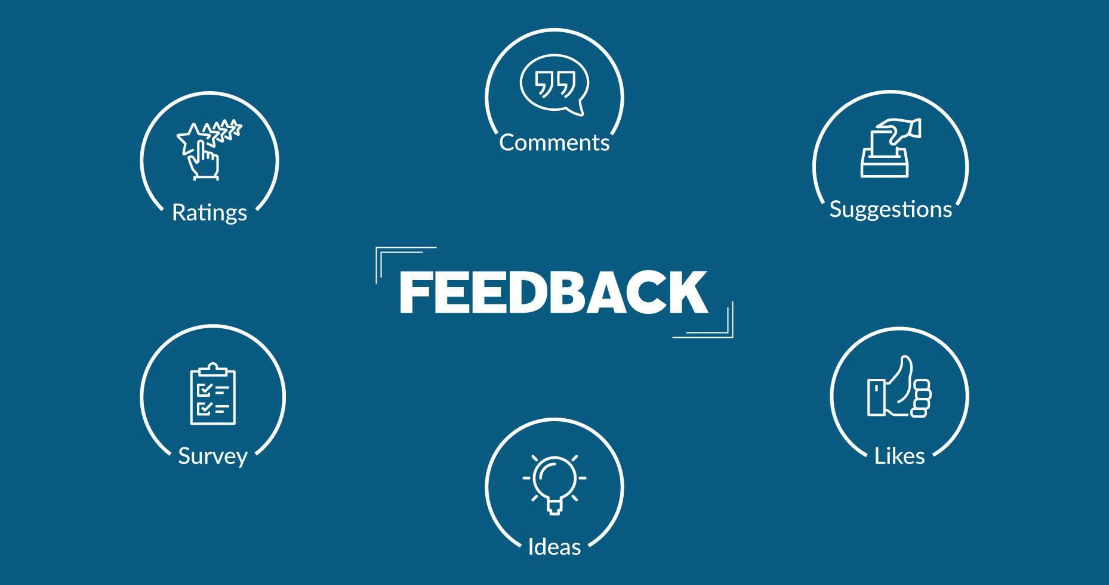
Copyright © 2017, edureka and/or its affiliates. All rights reserved.

Slide 70


